Slide 1




Bootcamp #3
- DevOps
WELCOME

Slide 2

[Pavlos Xouplidis]
[Working with Git and GitHub]
[21/10/2024]

Slide 3

In this Course
Understand why we need Git workflows
Get to know the benefits of each one and how we can choose the right one
Implemented you first workflow in a git repository
You have created branches based on common workflows
You have explored useful GitHub projects and feature to boost your coding carrier
You understand How not to D.R.Y

Slide 4
Discussion
[ Git Flows?]

Slide 5
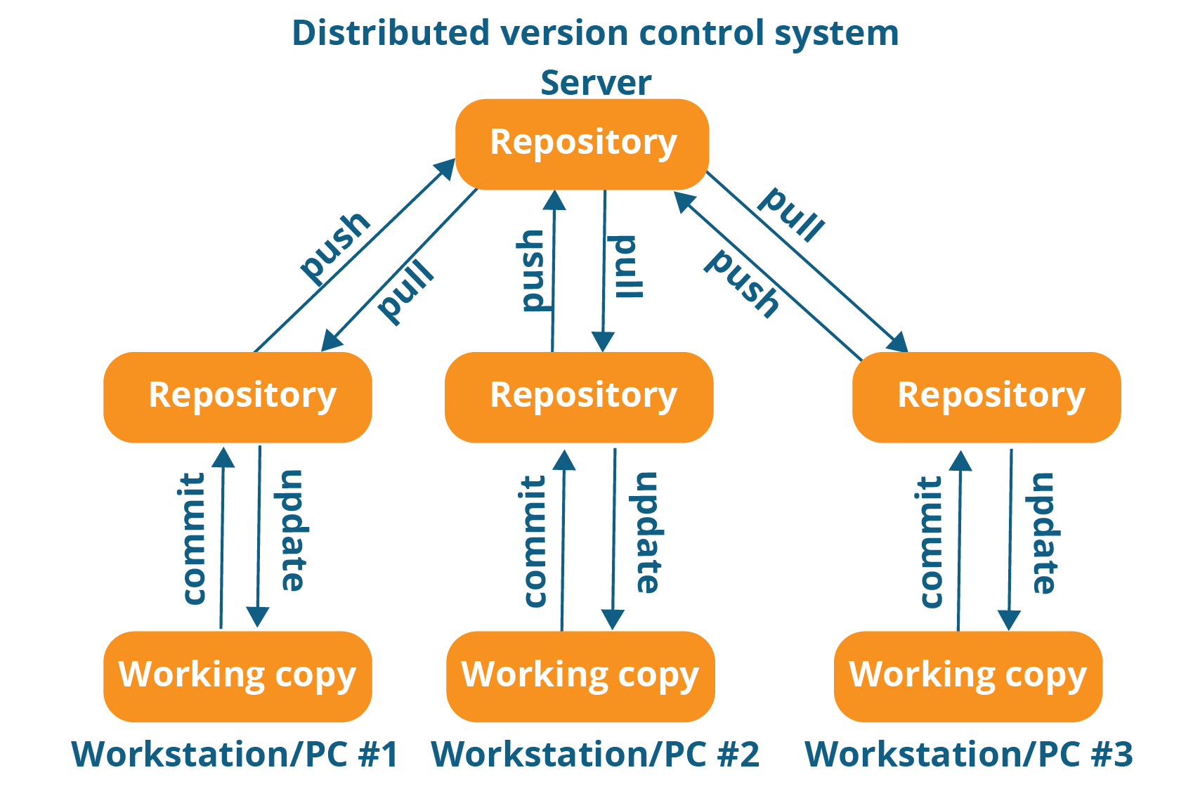
Git Collaboration

Slide 6
Git Flows Definition
Git flows provide structured methods for managing source code, feature development, and releases using Git.

Slide 7
Git Flows - Why use them?
When working with a team on a Git-managed project, it’s important to make sure the team is all in agreement on how the flow of changes will be applied. To ensure the team is on the same page, an agreed-upon Git workflow should be developed or selected.

Slide 8
What makes a successful Git workflow?
Does this workflow scale with team size?
Is it easy to undo mistakes and errors with this workflow?
Does this workflow impose any new unnecessary cognitive overhead to the team?

Slide 9
Most Common Git flows
Git Flow
GitHub Flow
GitLab Flow
Trunk-Based Development
Forking Workflow

Slide 10
Git Flow
Git Flow model is a well-structured flow that is popular for projects with a defined release cycle. Git Flow involves multiple long-running branches.

Slide 11
Git Flow Characteristics
Main branches:
main : This branch always contains the production-ready code.
develop: This is the default branch for ongoing development. All features are merged here before the release.

Slide 12
Git Flow Characteristics
Supporting branches:
Feature branches: Branches created for new features or updates, usually created off develop. Merged back into develop.
Release branches: Created when preparing for a release (e.g., release/1.0). Used for final bug fixes and testing before merging into main. Merged into both develop and main.
Hotfix branches: Created off main for urgent fixes to production. Merged into both develop and main.

Slide 13
Git Flow Pros & Cons
Pros:
Clear separation of different types of development (features, releases, hotfixes). Works well with larger teams and long-running projects.
Cons:
Can be overcomplicated for smaller teams or projects with fast iterations.

Slide 14
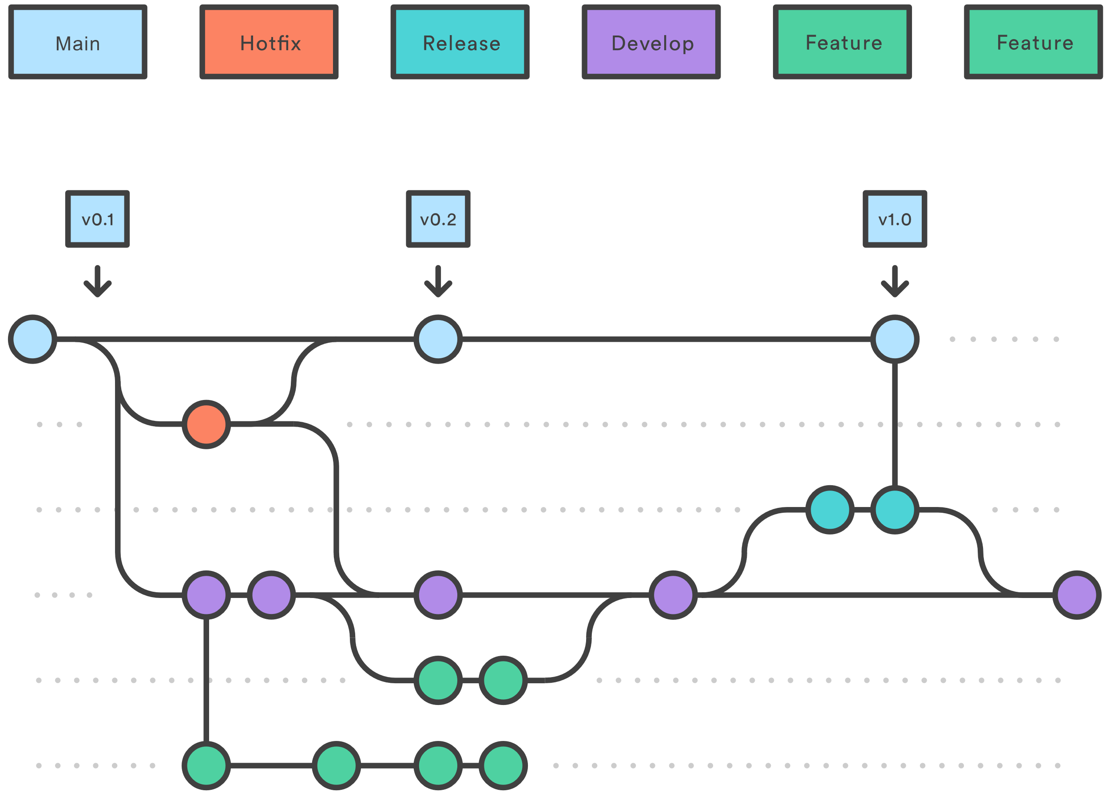
Git Flow visually

Slide 15
GitHub Flow
GitHub Flow is a simpler workflow focused on continuous deployment and integration, commonly used in smaller projects or in environments that deploy often (like web development).

Slide 16
GitHub Flow
Main branch:
main: This branch contains the code that's always ready for production.

Slide 17
GitHub Flow
Branching:
Developers create feature branches off the main branch for new work.
Once a feature is complete, a pull request is opened to merge the branch back into main. After code review and CI (Continuous Integration) checks, the branch is merged, and the main branch is deployed.

Slide 18
GitHub Flow
Pros:
Simple and easy to use.
Suitable for small teams and projects with frequent releases.
Integrates well with continuous delivery and deployment pipelines.
Cons:
Not ideal for projects with multiple release cycles or long-term development.

Slide 19
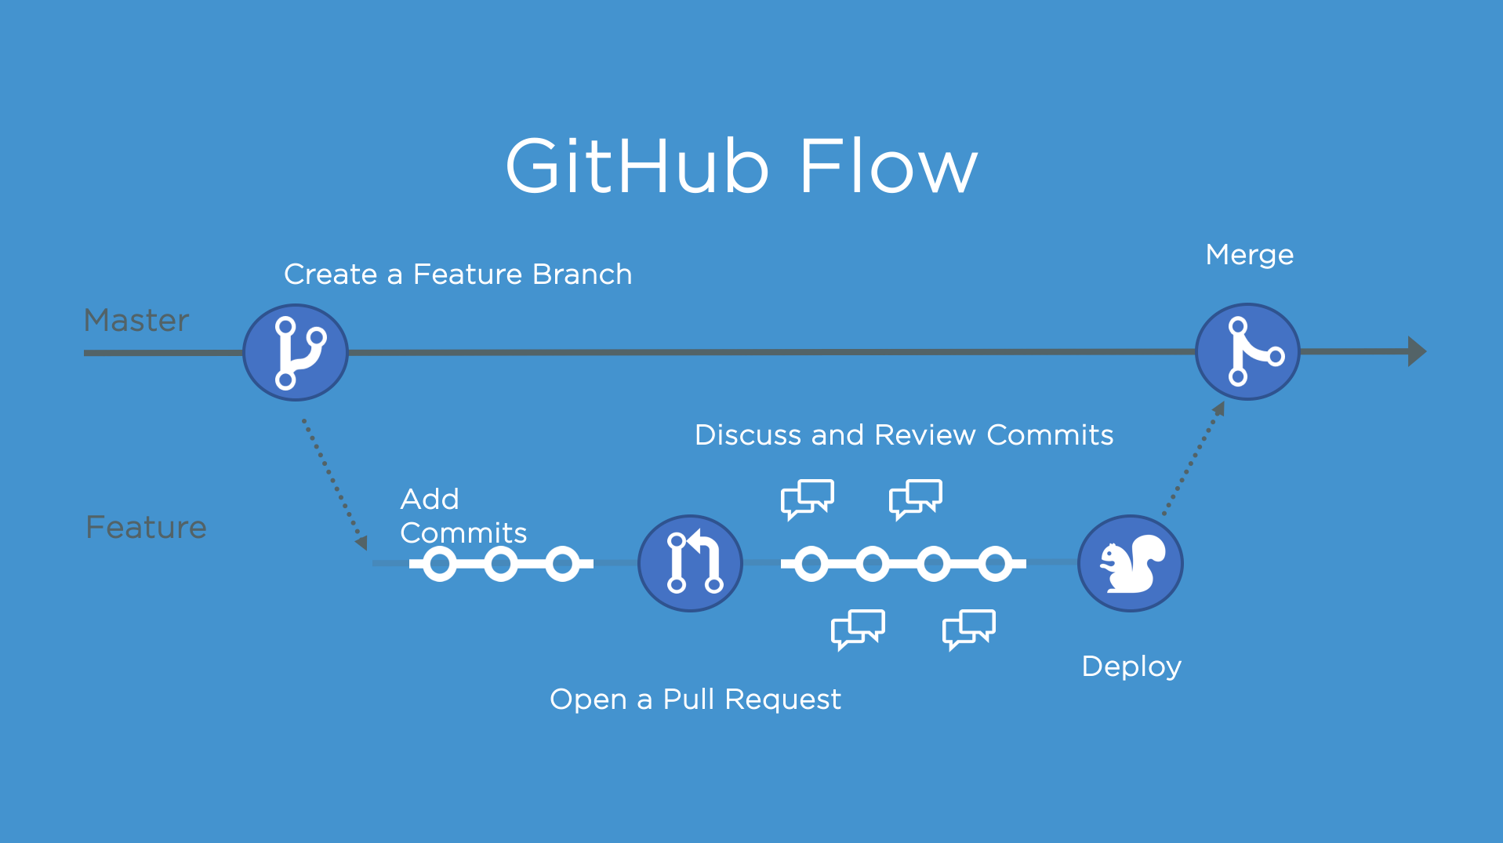
GitHub Flow Visually

Slide 20
GitLab Flow
GitLab Flow is a more flexible Git workflow than GitHub Flow, and it incorporates some elements of Git Flow. It’s designed to integrate development with production deployment more efficiently, especially in projects with multiple environments (like staging and production).

Slide 21
GitLab Flow
Main branch:
main: This is the production-ready branch.

Slide 22
GitLab Flow
Branching:
Feature branches: Like GitHub Flow, features are developed in short-lived feature branches.
Environment branches: GitLab Flow uses additional branches like staging or pre-production for testing before final deployment.

Slide 23
GitLab Flow
Merging:
Feature branches are merged into environment branches before going live. Once tested, the code is merged into main and deployed.

Slide 24
GitLab Flow pros & cons
Pros:
Handles complex workflows with multiple environments.
Good for teams using continuous deployment to various environments.
Cons:
Can be more complex than GitHub Flow, especially for smaller teams.

Slide 25
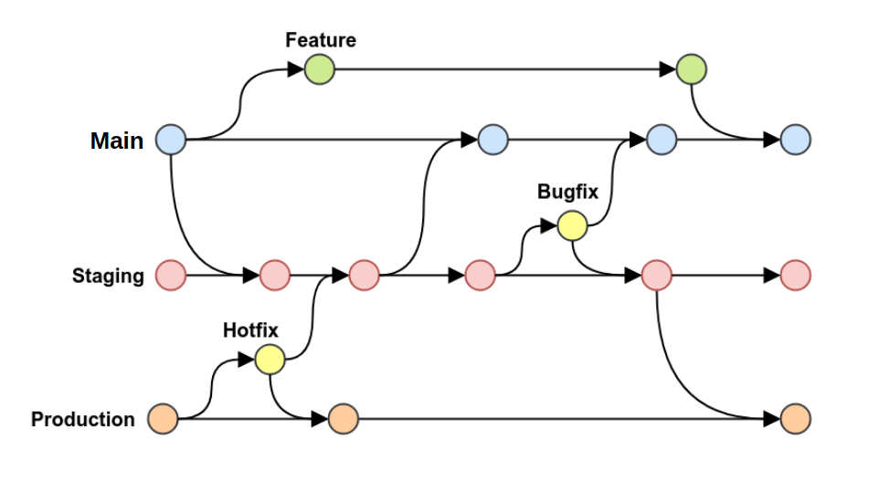
GitLab Flow Visually

Slide 26
Trunk-Based Development
Trunk-Based Development (TBD) is a streamlined Git workflow where developers work directly on a single main branch (called "trunk" or main), without long-lived feature branches. It encourages frequent small commits and collaboration.

Slide 27
Trunk-Based Development
Main branch:
All developers commit directly to main (or a short-lived feature branch that is quickly merged).

Slide 28
Trunk-Based Development
Branching:
Short-lived branches (if used at all) are merged back into main in a matter of hours or days. Features are developed and merged frequently to ensure the main branch is always deployable.

Slide 29
Trunk-Based Pros & Cons
Pros:
Encourages continuous integration and small, incremental changes.
Reduces merge conflicts and encourages collaboration.
Ideal for teams practicing continuous delivery or DevOps.
Cons:
Requires disciplined use of automated testing and CI pipelines.
Riskier in larger teams without strong testing and review processes.

Slide 30

Trunk-Based development Visually

Slide 31
Forking Workflow
Forking Workflow is commonly used in open-source projects. Instead of working within a shared repository, each developer creates a fork of the repository and works on their own copy.

Slide 32
Forking Workflow
Main branch:
The official repository maintains the production-ready main branch.

Slide 33
Forking Workflow
Branching: Developers create their own forks of the main repository and work on feature branches in their own forks.
When work is complete, they submit a pull request to the original repository for code review and merge.

Slide 34
Forking Workflow
Pros:
Good for large-scale open-source projects where many external contributors are involved.
Allows maintainers to review and control what gets merged.
Cons:
More complex setup than typical workflows for contributors.
More steps are involved in contributing and maintaining changes.

Slide 35
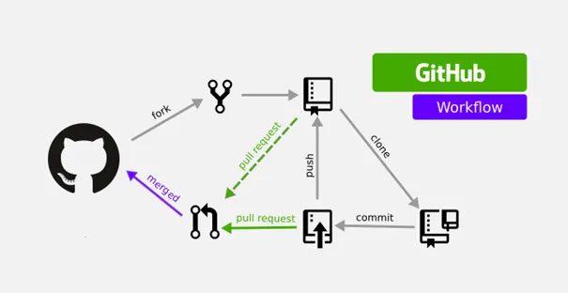
Forking Workflow

Slide 36
Summary of Popularity and Use Cases
Git Flow: Great for large teams, structured projects, or those with a defined release cycle.
GitHub Flow: Best for small teams or projects with continuous integration and fast release cycles.
GitLab Flow: Ideal for teams working with multiple environments and continuous deployment practices.
Trunk-Based Development: Suitable for high-collaboration environments with continuous delivery practices.
Forking Workflow: Most common in open-source projects and large community-driven projects.

Slide 37
Hands on
Go to your GitHub Account and fork the repository https://github.com/xpaulos/TechproWinter2024_session3

Slide 38
GitHub useful
https://github.com/practical-tutorials/project-based-learning
https://github.com/kamranahmedse/developer-roadmap
https://github.com/donnemartin/system-design-primer
https://github.com/ByteByteGoHq/system-design-101
https://github.com/InterviewReady/system-design-resources
https://github.com/karanpratapsingh/system-design
https://github.com/microsoft/AI-For-Beginners

Slide 39
D.R.Y
DRY is a software development principle that stands for “Don’t Repeat Yourself.” Living by this principle means that your aim is to reduce repetitive patterns and duplicate code and logic in favor of modular and referenceable code.

Slide 40
D.R.Y
DRY code is one of the practices that makes a good developer, a great developer. Solving a problem by any means is great to a point, but eventually, you need to be able to write code that's maintainable by people other than yourself and scalable as system load increases.

Slide 41
W.E.T
WET, which stands for “Write Everything Twice,” is the opposite of DRY.

Slide 42
By the end of this Course
Understand why we need Git workflows
You know the benefits of each one and how we can choose the right one
You have implemented you first workflow in your git repository
You have Created branches based on common workflows
You have explored useful GitHub projects and feature to boost your coding carrier
You understand How not to D.R.Y

Slide 43

Homework
Check the D.R.Y guide
https://www.getdbt.com/blog/guide-to-dry
Complete the Tic-Tac-Toe, uploaded to your GitHub account and use GitHub flow to make changes and merge them!
https://react.dev/learn

Slide 44
Feedback Discussion

Slide 45
Thank you

